Slide 1
CS 355/555
Probability and Statistics for Computer Scientists
Baocheng Geng
Lecture 5, 01/27/2024
CS 355/555 Probability and Statistics for Computer Scientists

Slide 2





Introduction
Conditional Probability
Introduction
Conditional Probability Examples
Example 1.6
Multiplication Rule Example 1.7
Example 1.8
Example 1.9
Example 1.10
5 Next Time
3
4
CS 355/555 Probability and Statistics for Computer Scientists

Slide 3
Copyright Statement
Copyright Statement
Materials prepared for and/or included in this course are protected by copyright law. They are intended to be used only by students enrolled in this course during the current term and should not be further disseminated without prior permission from the course instructor.
CS 355/555 Probability and Statistics for Computer Scientists

Slide 4
Birthday Problem in This Class
At least one student has birthday in this week, or I will take attendance.
CS 355/555 Probability and Statistics for Computer Scientists
4/

Slide 5


Birthday Problem in This Class
I claim that at least one student has birthday in this week
Denote $W_{i}$ to be the event that at least one out of i people has birthday in this week
      $P\left(W_{1}\right)=\frac{7}{365}≈0.019$
CS 355/555 Probability and Statistics for Computer Scientists
4/

Slide 6
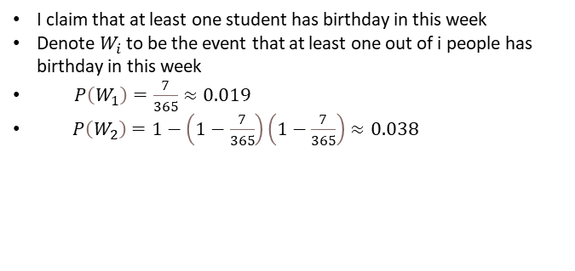
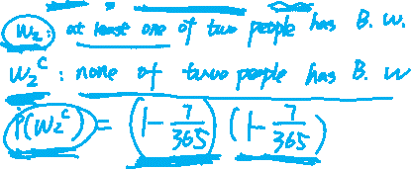
Birthday Problem in This Class
I claim that at least one student has birthday in this week
Denote $W_{i}$ to be the event that at least one out of i people has birthday in this week
      $P\left(W_{1}\right)=\frac{7}{365}≈0.019$
      $P\left(W_{2}\right)=1−\left(1−\frac{7}{365}\right)\left(1−\frac{7}{365}\right)≈0.038$
CS 355/555 Probability and Statistics for Computer Scientists
4/

Slide 7
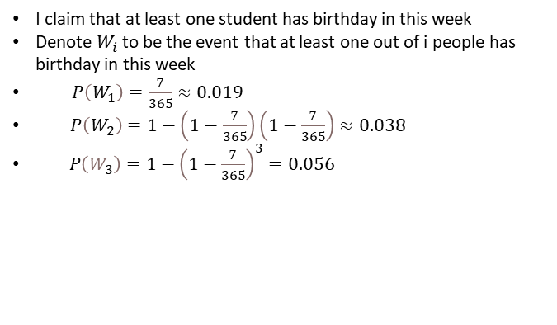

Birthday Problem in This Class
I claim that at least one student has birthday in this week
Denote $W_{i}$ to be the event that at least one out of i people has birthday in this week
      $P\left(W_{1}\right)=\frac{7}{365}≈0.019$
      $P\left(W_{2}\right)=1−\left(1−\frac{7}{365}\right)\left(1−\frac{7}{365}\right)≈0.038$
      $P\left(W_{3}\right)=1−{\left(1−\frac{7}{365}\right)}^{3}=0.056$
CS 355/555 Probability and Statistics for Computer Scientists
4/

Slide 8
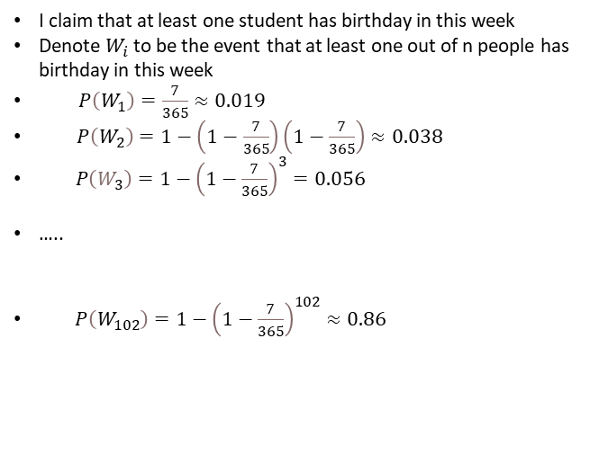

Birthday Problem in This Class
I claim that at least one student has birthday in this week
Denote $W_{i}$ to be the event that at least one out of n people has birthday in this week
      $P\left(W_{1}\right)=\frac{7}{365}≈0.019$
      $P\left(W_{2}\right)=1−\left(1−\frac{7}{365}\right)\left(1−\frac{7}{365}\right)≈0.038$
      $P\left(W_{3}\right)=1−{\left(1−\frac{7}{365}\right)}^{3}=0.056$
      …..
      $P\left(W_{102}\right)=1−{\left(1−\frac{7}{365}\right)}^{102}≈0.86$
CS 355/555 Probability and Statistics for Computer Scientists
4/

Slide 9

Conditional Probability
I flip four coins. At least one of them is a tail.
What is the probability that there are exactly three heads?
CS 355/555 Probability and Statistics for Computer Scientists
4/

Slide 10

Conditional Probability
I flip four coins. At least one of them is a tail.
What is the probability that there are exactly three heads? Let A = Exactly three heads
Let B = At least one tail
What is the probability of A given B?
CS 355/555 Probability and Statistics for Computer Scientists
4/

Slide 11

Conditional Probability
P (A|B)
P (A|B) = ^{P (A∩B)}
P (B)
CS 355/555 Probability and Statistics for Computer Scientists
5/

Slide 12
Conditional Probability
P (A|B)
P (A|B) = ^{P (A∩B)}
P (B)
I flip four coins. At least one of them is a tail.
What is the probability that there are exactly three heads?
CS 355/555 Probability and Statistics for Computer Scientists
5/

Slide 13

Conditional Probability
P (A|B)
P (A|B) = ^{P (A∩B)}
P (B)
I flip four coins. At least one of them is a tail.
What is the probability that there are exactly three heads? Define some events:
A: Exactly three heads out of four flips B: At least one tail out of four flips
CS 355/555 Probability and Statistics for Computer Scientists
5/

Slide 14

Conditional Probability
I flip four coins. At least one of them is a tail.
What is the probability that there are exactly three heads?
H | H | H | H
H | H | H | T
H | H | T | H
H | H | T | T
H | T | H | H
H | T | H | T
H | T | T | H
H | T | T | T
T | H | H | H
T | H | H | T
T | H | T | H
T | H | T | T
T | T | H | H
T | T | H | T
T | T | T | H
T | T | T | T
CS 355/555 Probability and Statistics for Computer Scientists

Slide 15
Conditional Probability
I flip four coins.
What is the probability that there are exactly three heads?
H | H | H | T
H | H | T | H
H | T | H | H
T | H | H | H
4 1
P (A) = =
16 4
CS 355/555 Probability and Statistics for Computer Scientists

Slide 16

Conditional Probability
I flip four coins. At least one of them is a tail.
What is the probability that there are exactly three heads?
T | H | H | H
T | H | H | T
T | H | T | H
T | H | T | T
T | T | H | H
T | T | H | T
T | T | T | H
T | T | T | T
H | H | H | T
H | H | T | H
H | H | T | T
H | T | H | H
H | T | H | T
H | T | T | H
H | T | T | T
15
16
P (B) =
CS 355/555 Probability and Statistics for Computer Scientists

Slide 17
Conditional Probability
P (A ∩ B)
P (A|B) =
P (B)
I flip four coins. At least one of them is a tail.
What is the probability that there are exactly three heads?
CS 355/555 Probability and Statistics for Computer Scientists
9/

Slide 18

Conditional Probability
P (A ∩ B)
P (A|B) =
P (B)
I flip four coins. At least one of them is a tail.
What is the probability that there are exactly three heads?
A ∩ B = A
1
4
P (A ∩ B) = P (A) =
CS 355/555 Probability and Statistics for Computer Scientists
9/

Slide 19
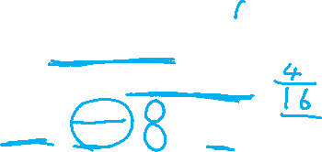
Conditional Probability
I flip four coins. At least one of them is a tail.
What is the probability that there are exactly three heads?
P (A ∩ B)
1 4
4
15
P (A|B) =
₌ 4 ₌ 16 ₌
P (B)
15 15
16 16
CS 355/555 Probability and Statistics for Computer Scientists

Slide 20

Conditional Probability
P (Ω ∩ B)
P (Ω|B) =
P (B)
P (B)
=
P (B)
= 1
CS 355/555 Probability and Statistics for Computer Scientists
11/

Slide 21
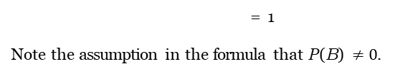

Conditional Probability
P (Ω ∩ B)
P (Ω|B) =
P (B)
P (B)
=
P (B)
= 1
Note the assumption in the formula that P (B) $≠0$.
CS 355/555 Probability and Statistics for Computer Scientists
11/

Slide 22
Example 1.6
Ω = {Three coin tosses}
What is P(more heads in three tosses if the first toss is H)?
H | H | H
H | H | T
H | T | H
H | T | T
T | H | H
T | H | T
T | T | H
T | T | T
A = more heads than tails = HHH, HHT, HTH, THH
B = first toss is heads = HHH, HHT, HTH, HTT
CS 355/555 Probability and Statistics for Computer Scientists

Slide 23
Conditional Probability
A = more heads than tails = HHH, HHT, HTH, THH
B = first toss is heads = HHH, HHT, HTH, HTT
A ∩ B = {HHH, HHT, HTH}
3
8
P (A ∩ B) =
4 1
P (B) = =
8 2
P (A ∩ B)
P (A|B) =
P (B)
3/8 3
= =
4/8 4
CS 355/555 Probability and Statistics for Computer Scientists

Slide 24
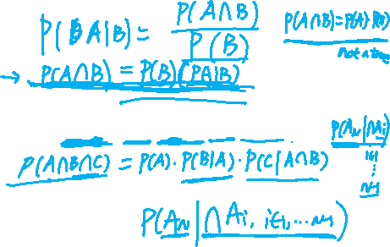
Multiplication Rule
Multiplication Rule
P (∩A_{i}) = P (A₁)P (A₂|A₁)P (A₃|A₁ ∩ A₂) . . .
CS 355/555 Probability and Statistics for Computer Scientists

Slide 25
Example 1.7 Page 21
A fair 4-sided die is rolled twice and all outcomes are equally likely. Let X and Y be the result of the first and second rolls.
Let B be the event that the minimum roll of the two dice is 2. What is P ({max(X, Y ) = m}|B)?
CS 355/555 Probability and Statistics for Computer Scientists
15/

Slide 26
Example 1.7 Page 21
A fair 4-sided die is rolled twice and all outcomes are equally likely. Let X and Y be the result of the first and second rolls.
Let B be the event that the minimum roll of the two dice is 2. What is P ({max(X, Y ) = m}|B)?
m = 1, 2, 3, 4
CS 355/555 Probability and Statistics for Computer Scientists
15/

Slide 27
Example 1.7 Page 21
Four sided die, roll twice, X= first, Y = second
For integer m ∈ {1, 2, 3, 4}, A_{m} = max(X, Y ) .
A_{m} = {max(X, Y ) = m, m = 1, 2, 3, 4}
B = {min(X, Y ) = 2}
Want P (A_{m}|B) for m = 1, 2, 3, 4
CS 355/555 Probability and Statistics for Computer Scientists

Slide 28
Example 1.7
P (A∩B)
P (A|B) =
P (B)
 | 1 | 2 | 3 | 4
1
2
3
4
CS 355/555 Probability and Statistics for Computer Scientists

Slide 29
Example 1.7
P (A ∩ B)
P (A|B) =
P (B)
 | 1 | 2 | 3 | 4
1 | a
2 |  | b | b | b
3 |  | b
4 |  | b
5
16
P (B) =
#(A₁ ∩ B) = 0
0
P (A₁|B) = ₁₆ = 0
CS 355/555 Probability and Statistics for Computer Scientists

Slide 30
Example 1.7
P (A ∩ B)
P (A|B) =
P (B)
 | 1 | 2 | 3 | 4
1 |  | a
2 | a | ab | b | b
3 |  | b
4 |  | b
5
16
P (B) =
#(A₂) = 3 #(A₂ ∩ B) = 1
1
1
5
P (A₂|B) = ¹⁶ =
5
16
CS 355/555 Probability and Statistics for Computer Scientists

Slide 31
Example 1.7
P (A ∩ B)
P (A|B) =
P (B)
 | 1 | 2 | 3 | 4
1 |  |  | a
2 |  | b | ba | b
3 | a | ab | a
4 |  | b
5
16
P (B) =
#(A₃) = 5 #(A₃ ∩ B) = 2
2
P (A₃|B) = ¹⁶ =
2
5
16
5
CS 355/555 Probability and Statistics for Computer Scientists

Slide 32
Example 1.7
P (A ∩ B)
P (A|B) =
P (B)
 | 1 | 2 | 3 | 4
1 |  |  |  | a
2 |  | b | b | a b
3 |  | b |  | a
4 | a | a b | a | a
5
16
P (B) =
#(A₄) = 5 #(A₄ ∩ B) = 2
2
P (A₄|B) = ¹⁶ =
2
5
16
5
CS 355/555 Probability and Statistics for Computer Scientists

Slide 33
Example 1.7 - Check the results
1 2 2
A₁ + A₂ + A₃ + A₄ = 0 + ₅ + ₅ + ₅ = 1
CS 355/555 Probability and Statistics for Computer Scientists

Slide 34
Example 1.8
There are two groups of students in CS 355, labeled C and N for conservative¹ and innovative.
They are given assignments to write programs. Based on experience:
P(C successful) = 2/3 P(N successful) = 1/2
P(at least one successful) = 3/4 = 1 - P(no team successful)
Find P(N successful if at least one program is produced)
P (NS|NS ∪ CS)
¹This is about program design, not politics
CS 355/555 Probability and Statistics for Computer Scientists

Slide 35
Example 1.8
P(C successful) = 2/3 P(N successful) = 1/2
P(at least one successful) = 3/4 = 1 - P(no team successful)
Find P(N successful if at least one of them is successful)
 | CS | CF
NS |  |  | 1 2
NF |  | 1 4
 | 2 3 |  | 1
CS 355/555 Probability and Statistics for Computer Scientists

Slide 36
Example 1.8
 | CS | CF
NS |  |  | 1 2
NF |  | 1 4 | 1 2
 | 2 3 | 1 3 | 1
CS 355/555 Probability and Statistics for Computer Scientists

Slide 37
Example 1.8
 | CS | CF
NS |  | 1 12 | 1 2
NF | 1 4 | 1 4 | 1 2
 | 2 3 | 1 3 | 1
CS 355/555 Probability and Statistics for Computer Scientists

Slide 38
Example 1.8
 | CS | CF
NS | 5 12 | 1 6 | 1 2
NF | 1 4 | 1 4 | 1 2
 | 2 3 | 1 3 | 1
CS 355/555 Probability and Statistics for Computer Scientists
27/

Slide 39
Example 1.8
 | CS | CF
NS | 5 12 | 1 6 | 1 2
NF | 1 4 | 1 4 | 1 2
 | 2 3 | 1 3 | 1
1
=
2
3
P(N successful if at least one is successful) =
2
3
4
CS 355/555 Probability and Statistics for Computer Scientists
27/

Slide 40
Example 1.9
There is a radar system that generates an alarm when it detects an airplane.
If an aircraft is present, it generates an alarm with probability 99%. If an aircraft is not present, it generates a false alarm with probability 10%. The probability of there being an aircraft present is 5%.
What is P(no aircraft and an alarm)? What is P(aircraft present and no alarm)?
CS 355/555 Probability and Statistics for Computer Scientists

Slide 41
Example 1.9
What is P(no aircraft and an alarm)?
What is P(Aircraft present and no alarm)?
A = An aircraft is present
B = Radar generates an alarm
A^{C} = No aircraft is present
B^{C} = Radar does not generate an alarm
P(no aircraft and an alarm) = P (A^{C} ∩ B)
CS 355/555 Probability and Statistics for Computer Scientists
29/

Slide 42
Example 1.9
What is P(no aircraft and an alarm)?
What is P(Aircraft present and no alarm)?
A = An aircraft is present
B = Radar generates an alarm
A^{C} = No aircraft is present
B^{C} = Radar does not generate an alarm
P(no aircraft and an alarm) = P (A^{C} ∩ B) P(Aircraft present and no alarm) = P (A ∩ B^{C} )
CS 355/555 Probability and Statistics for Computer Scientists
29/

Slide 43
Example 1.9
If an aircraft is present, it generates an alarm with probability 99%. If an aircraft is not present, it generates a false alarm with probability 10%. The probability of there being an aircraft present is 5%.
P(no aircraft and an alarm)
=P (A^{C} ∩ B) = P (A^{C} )P (B|A^{C} ) = .95 × .1 = .095
CS 355/555 Probability and Statistics for Computer Scientists
30/

Slide 44
Example 1.9
If an aircraft is present, it generates an alarm with probability 99%. If an aircraft is not present, it generates a false alarm with probability 10%. The probability of there being an aircraft present is 5%.
P(no aircraft and an alarm)
=P (A^{C} ∩ B) = P (A^{C} )P (B|A^{C} ) = .95 × .1 = .095
P(Aircraft present and no alarm)= P (A)P (B^{C} |A) = .05 × .01 = .0005
CS 355/555 Probability and Statistics for Computer Scientists
30/

Slide 45
Example 1.9
4950 Plane present and alarm
5000 Plane present
5%
50 Plane present no alarm
100,000
9500 No plane, alarm
95000 No plane
89550 No plane, no alarm
Suppose alarm: P (plane present) = ⁴⁹⁵⁰ = ⁴⁹⁵⁰ = 34%
4950+9500 14450
Suppose no alarm: P (plane not present) = ⁹⁵⁰⁰ = 99.5%
9550
CS 355/555 Probability and Statistics for Computer Scientists

Slide 46
Example 1.10
Three cards are drawn from a 52 card deck, without replacement. What is the probability that none of the cards is a heart?
CS 355/555 Probability and Statistics for Computer Scientists
32/

Slide 47
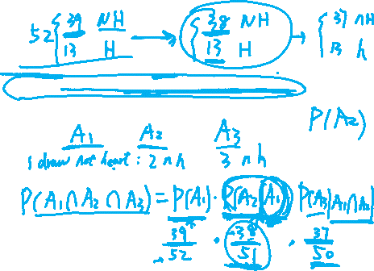
Example 1.10
Three cards are drawn from a 52 card deck, without replacement. What is the probability that none of the cards is a heart?
At each draw, each card is equally likely to be drawn.
CS 355/555 Probability and Statistics for Computer Scientists
32/

Slide 48
Example 1.10
Three cards are drawn from a 52 card deck, without replacement. What is the probability that none of the cards is a heart?
At each draw, each card is equally likely to be drawn.
Approach one: list each possible three card draw, count them, count the number of draws with no hearts, and divide.
CS 355/555 Probability and Statistics for Computer Scientists
32/

Slide 49
Example 1.10
Three cards are drawn from a 52 card deck, without replacement. What is the probability that none of the cards is a heart?
At each draw, each card is equally likely to be drawn.
Approach one: list each possible three card draw, count them, count the number of draws with no hearts, and divide.
No. Too hard.
CS 355/555 Probability and Statistics for Computer Scientists
32/

Slide 50
Let A_{i} be the probability that the i^{th} card is NOT a heart, i = 1, 2, 3
Example 1.10
CS 355/555 Probability and Statistics for Computer Scientists
33/

Slide 51
Example 1.10
Let A_{i} be the probability that the i^{th} card is not a heart, i = 1, 2, 3
We want P (A₁ ∩ A₂ ∩ A₃) = P (A₁)P (A₂|A₁)P (A₃|A₁ ∩ A₂)
CS 355/555 Probability and Statistics for Computer Scientists
33/

Slide 52
Example 1.10
39 3
P (A₁) = ₅₂ = ₄
CS 355/555 Probability and Statistics for Computer Scientists
34/

Slide 53
Example 1.10
39 3
P (A₁) = ₅₂ = ₄
38
P (A₂|A₁) = ₅₁
CS 355/555 Probability and Statistics for Computer Scientists
34/

Slide 54
Example 1.10
39 3
P (A₁) = ₅₂ = ₄
38
P (A₂|A₁) = ₅₁
37
P (A₃|A₁ ∩ A₂) = ₅₀
CS 355/555 Probability and Statistics for Computer Scientists
34/

Slide 55
Example 1.10
39 3
P (A₁) = ₅₂ = ₄
38
P (A₂|A₁) = ₅₁
37
P (A₃|A₁ ∩ A₂) = ₅₀
P (A₁ ∩ A₂ ∩ A₃) = P (A₁)P (A₂|A₁)P (A₃|A₁ ∩ A₂)
3 38 37
P (A₁ ∩ A₂ ∩ A₃) = ₄ ₅₁ ₅₀ = 0.4135
CS 355/555 Probability and Statistics for Computer Scientists
34/

Slide 56
Example 1.10
39 3
P (A₁) = ₅₂ = ₄
38
P (A₂|A₁) = ₅₁
37
P (A₃|A₁ ∩ A₂) = ₅₀
P (A₁ ∩ A₂ ∩ A₃) = P (A₁)P (A₂|A₁)P (A₃|A₁ ∩ A₂)
3 38 37
P (A₁ ∩ A₂ ∩ A₃) = ₄ ₅₁ ₅₀ = 0.4135
Figure 1.11, page 26
CS 355/555 Probability and Statistics for Computer Scientists
34/

Slide 57
Next Class
Read Chapter 1, 1.4 ppg 28 - 34
CS 355/555 Probability and Statistics for Computer Scientists
37/

